Slide 1
Linear Algebra
Lecture 29

Slide 2
Eigenvalues and
Eigenvectors

Slide 3
The Characteristic
Equation

Slide 4
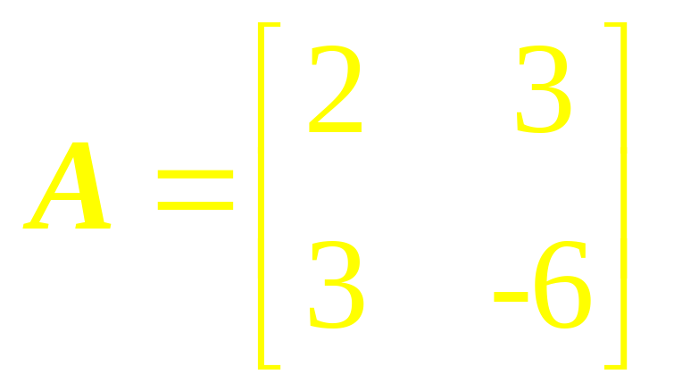
Example 1
Find the eigenvalues of

Slide 5
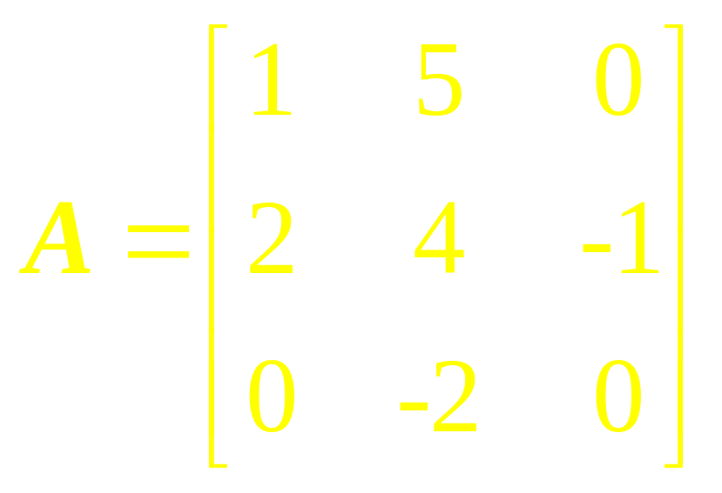
Example 2
Compute det A for

Slide 6



Properties of
Determinants
Let A and B be n x n matrices.
(a) A is invertible if and only if
(b)
(c)

Slide 7
(d) If A is triangular, then det A is the product of the entries on the main diagonal of A.
(e) A row replacement operation on A does not change the determinant.

Slide 8
(f) A row interchange changes the sign of the determinant.
(g) A row scaling also scales the determinant by the same scalar factor.

Slide 9
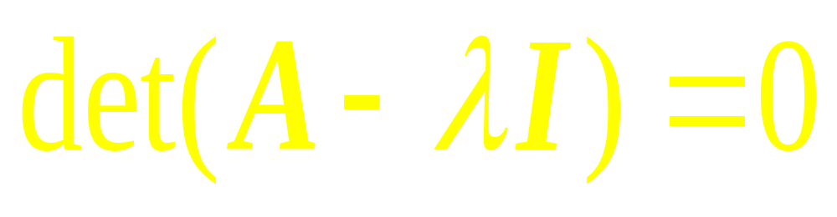
The Characteristic Equation

Slide 10
Examples

Slide 11
Similarity
If A and B are n x n matrices, then A is similar to B if there is an invertible matrix P such that P ⁻¹AP = B, or equivalently, A = PBP ⁻¹.

Slide 12
Similarity
Writing Q for P ⁻¹, we have Q ⁻¹BQ = A.
So B is also similar to A, and we say simply that A and B are similar.

Slide 13
Similarity
Transformation
Changing A into P ⁻¹AP is called a similarity transformation.

Slide 14
Theorem
If n x n matrices A and B are similar, then they have the same characteristic polynomial and hence the same eigenvalues (with the same multiplicities).

Slide 15
Application to
Dynamical Systems

Slide 16
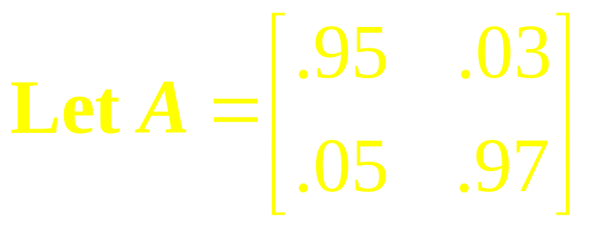
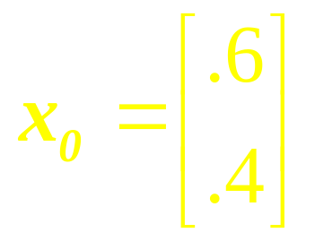
Example 7
Analyze the long – term behavior of the dynamical system defined by x_{k+1} = Ax_{k} (k = 0, 1, 2, …), with

Slide 17
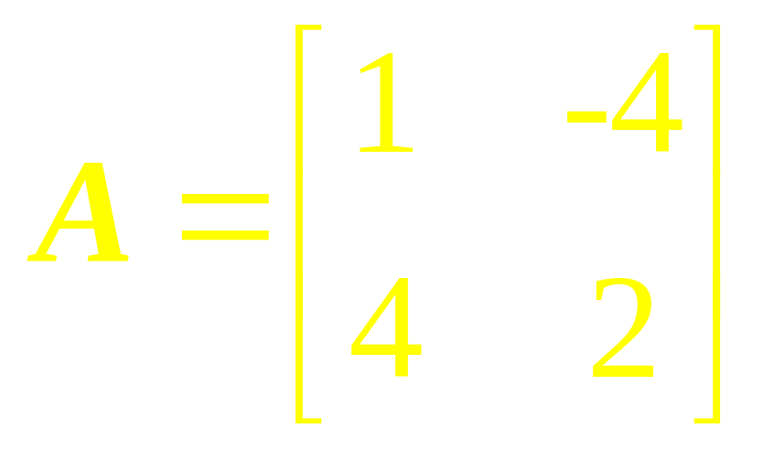
Example 8
Find the characteristic equation and eigenvalues of

Slide 18
Linear Algebra
Lecture 29

